Slide 1
CSE322
Regular Expressions and their Identities
Lecture #6

Slide 2
Regular Expressions
We give a formal recursive definition of regular expressions over ∑ as follows:
1. Any terminal symbol (i.e. an element of ∑), Λ and ∅ are regular
expressions. When we view a in ∑ as a regular expression, we denote it by a.
2. The union of two regular expressions R1and R2 , written as R 1 + R2, is also a regular expression.
3. The concatenation of two regular expressions R1and R2, written as
R1 R2, is also a regular expression.
4. The iteration (or closure) of a regular expression R written as R*, is
also a regular expression.
5.If R is a regular expression, then (R) is also a regular expression.
6. The regular expressions over∑ are precisely those obtained
recursively by the application of the rules 1-5 once or several times

Slide 3
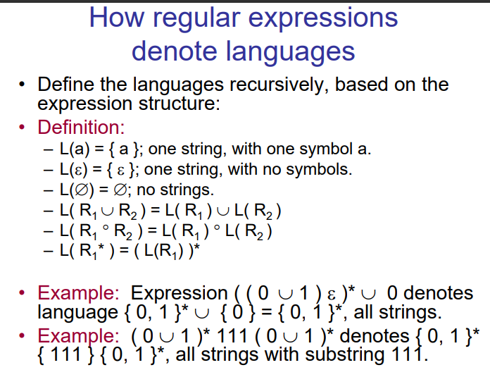

Slide 4


Slide 6
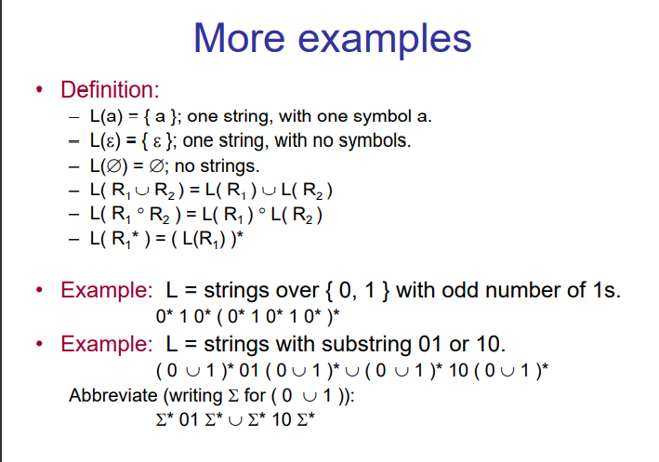

Slide 7
Definitions
Any set represented by a regular expression is called a regular set.
If for example, a, b ε ∑. Then
(i) a denotes the set {a},
(ii) a + b denotes {a, b},
(iii) ab denotes {ab},
(iv) a* denotes the set {lambda, a, aa. aaa, ... } and
(v) (a + b)* denotes {a, b}*. The set represented by R is denoted by L(R),
Notes:
Definitions

Slide 8
Questions
Describe the following sets by regular expressions:
{101}
{abba}
{01,10}
{Λ ,ab}
{abb,a, b, bba}
{Λ , 0, 00, 000.... }
{1, 11, 111 ... }

Slide 9
Solution
(a) Now. {1}. {O} are represented by 1 and O. respectively. 101 is obtained
by concatenating 1,0 and 1 So. {10 I} is represented by 101.
(b) abba represents {abba}.
(c) As {01, 10} is the union of {01} and {10}, we have {01, 10}
represented by 01 + 10
(d) The set {Λ , ab} is represented by Λ + ab
(e) The set {abb, a, b, bba} is represented by abb + a + b + bba.
f) As {Λ , 0, 00, 000, ... } is simply {O}*. it is represented by 0*
(g) Any element in {1, 11, 111, ... } can be obtained by concatenating
1 and any element of {1}*. Hence 1(1)* represents {1, 11, 111, ... }

Slide 10
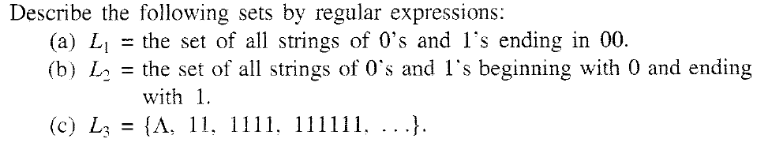
Problem

Slide 11
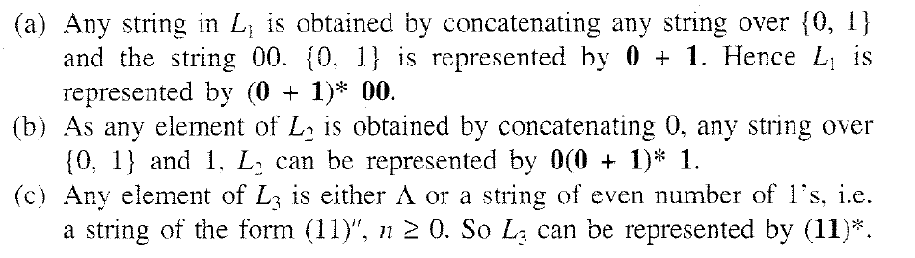
Solution

Slide 12
Practice questionson R.E
Find a regular expression corresponding to the language of all strings over the alphabet { a, b } that contain exactly two a's.
Solution is : A string in this language must have at least two a's. Since any string of b's can be placed in front of the first a, behind the second a and between the two a's, and since an arbitrasry string of b's can be represented by the regular expression b*, b*a b*a b* is a regular expression for this language

Slide 13
Find a regular expression corresponding to the language of all strings over the alphabet { a, b } that do not end with ab.
Solution : Any string in a language over { a , b } must end in a or b. Hence if a string does not end with ab then it ends with a or if it ends with b the last b must be preceded by a symbol b. Since it can have any string in front of the last a or bb, ( a + b )*( a + bb ) is a regular expression for the language.

Slide 14
Find a regular expression corresponding to the language of strings of even lengths over the alphabet of { a, b }.
Solution: Since any string of even length can be expressed as the concatenation of strings of length 2 and since the strings of length 2 are aa, ab, ba, bb, a regular expression corresponding to the language is ( aa + ab + ba + bb )*. Note that 0 is an even number. Hence the string Lambda is in this language.

Slide 16
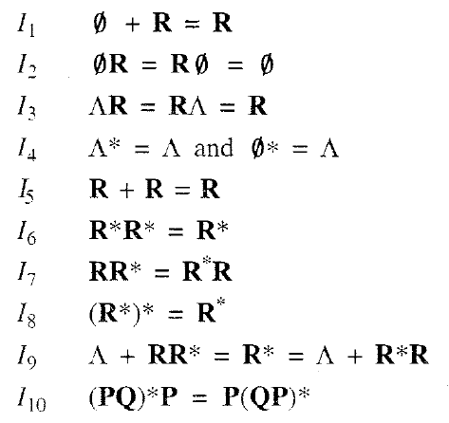

IDENTITIES FOR REGULAR EXPRESSIONS
Notes:
IDENTITIES FOR REGULAR EXPRESSIONS

Slide 18
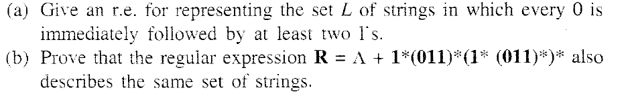
PROBLEM

Slide 19
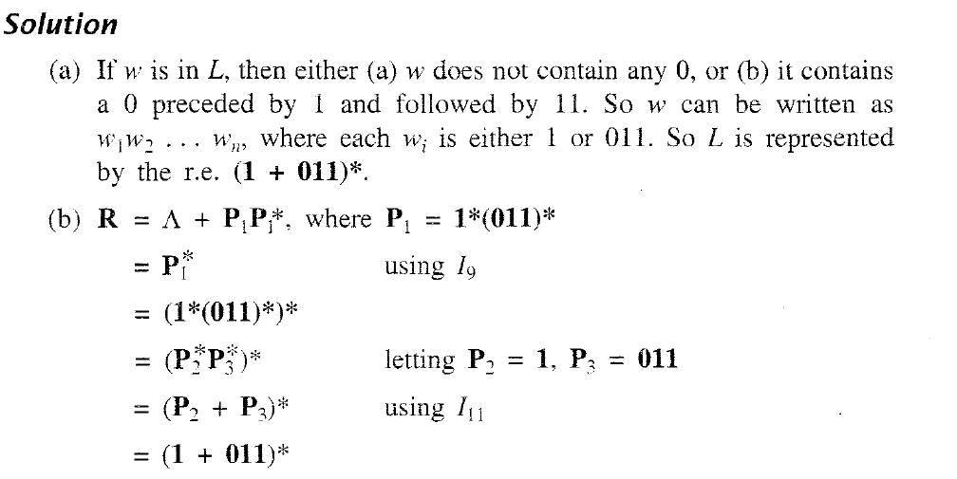
SOLUTION

Slide 20
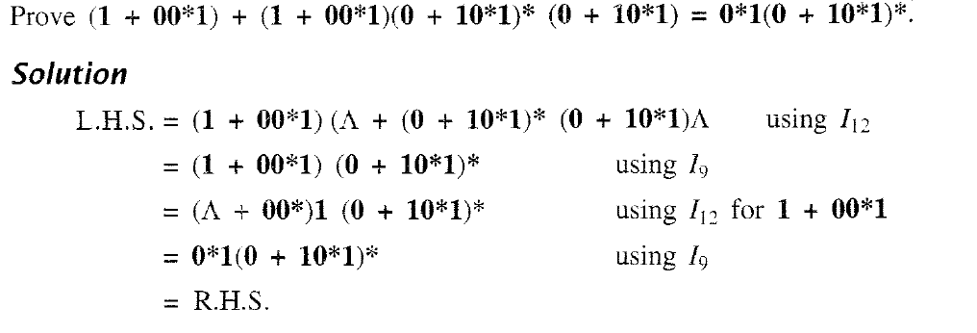
PROBLEM & SOLUTION

Slide 21
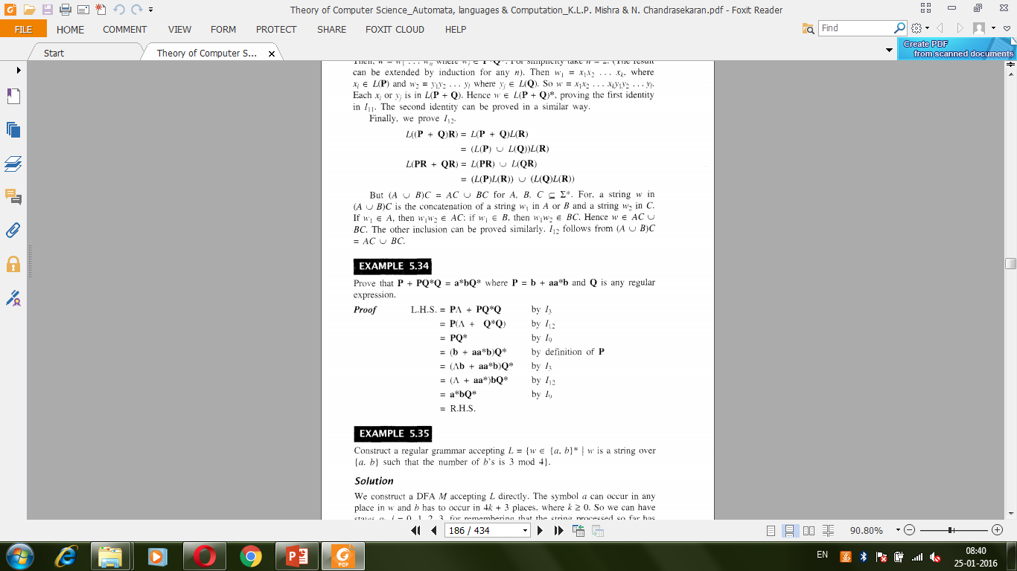

Slide 23
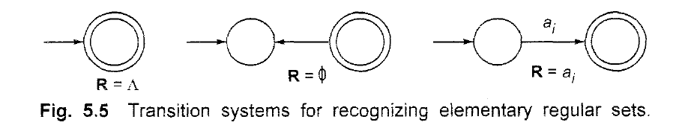
Difference between Null and Ø

Slide 24
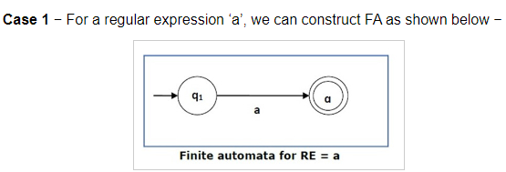
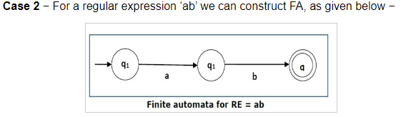
Convert the regular expression (RE) to Finite Automata (FA),

Slide 25
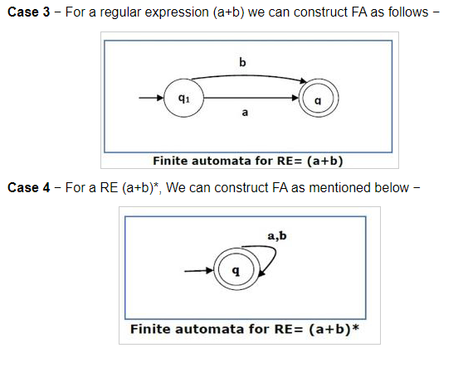

Slide 26
EX#1
ba+(a+bb).a*.b

Slide 27
EX#2
10 + (0+11).0*.1

Slide 28
TRANSITION SYSTEM CONTAINING Λ -MOVES
Suppose we want to replace a Λ -move from vertex V1 to vertex V2' Then
we proceed as follows:
Step 1- Find all the edges starting from V2.
Step 2- Duplicate all these edges starting from V1' without changing the edge
labels.
Step 3- If V1 is an initial state, make V2 also as initial state.
Step 4- If V2 is a final state. make V1 also as the final state.

Slide 29
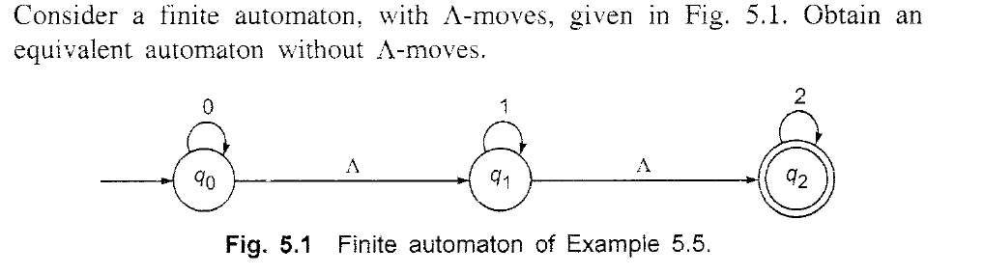
EXAMPLE

Slide 30
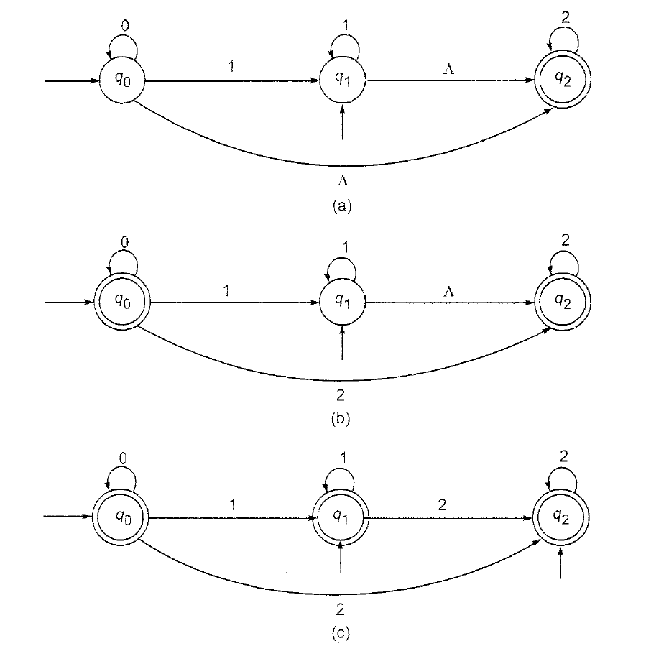
EXAMPLE

Slide 31
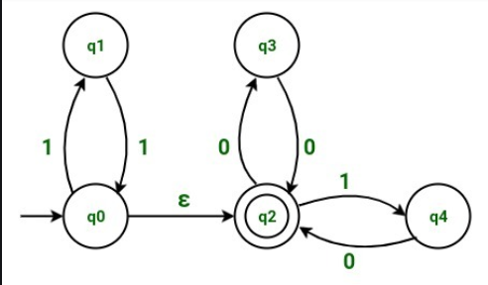
EX#2

Slide 32
Construct RE from given FA
Theorem :
(Arden' s theorem) Let P and Q be two regular expressions over ∑. If P does not contain Λ, then the following equation in R, namely
R = Q + RP
has a unique solution (i.e. one and only one solution) given by R = QP*.

Slide 33
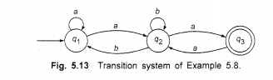
Construct RE from given FA

Slide 34
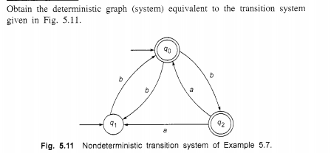

Slide 35
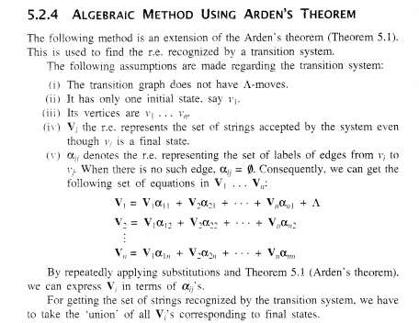

Slide 36
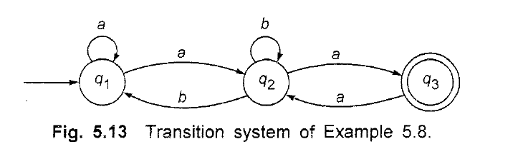
Construct RE from Finite Automata

Slide 37
answer
(a + a(b + aa)*b)*a(b + aa)*a

Slide 38
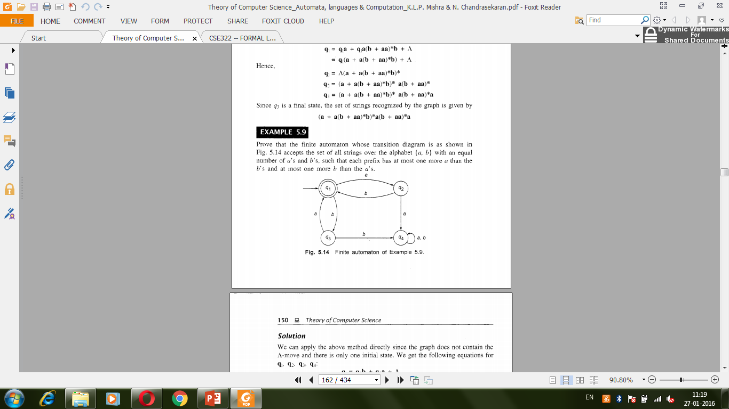
Construct RE from given DFA

Slide 39
Answer
(ab + ba)*

Slide 40
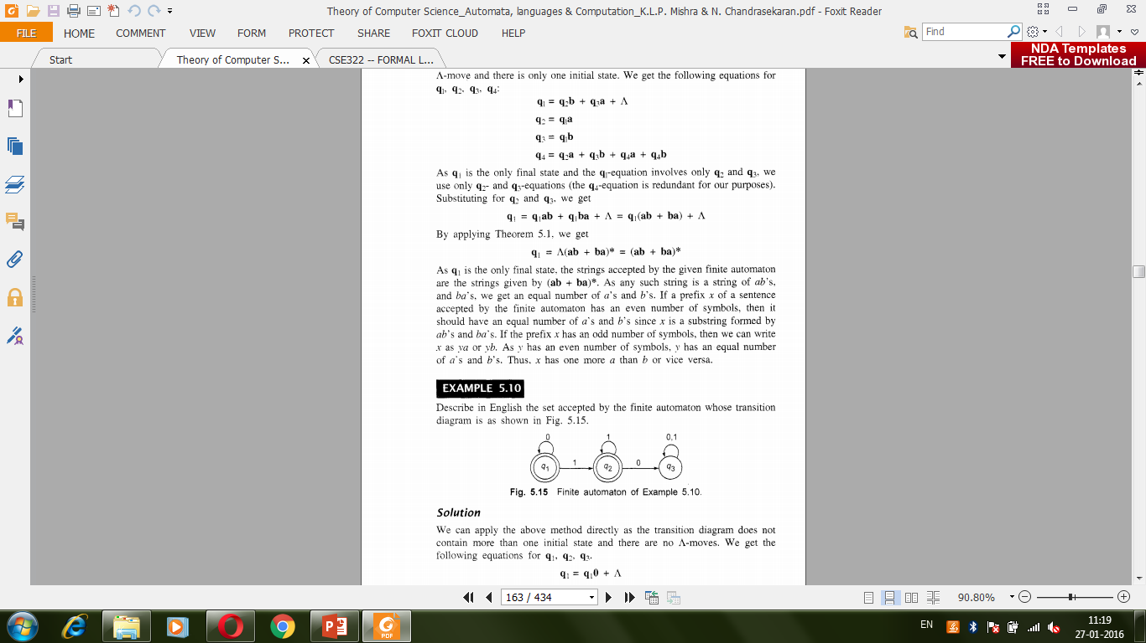
Construct RE from given DFA, take q1 as initial state

Slide 41
Answer
0*(1*)

Slide 42
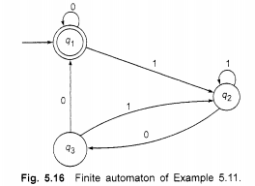
Construct RE from given DFA

Slide 43
Answer
(0 + 1(1 + 01)* 00)*

Slide 44
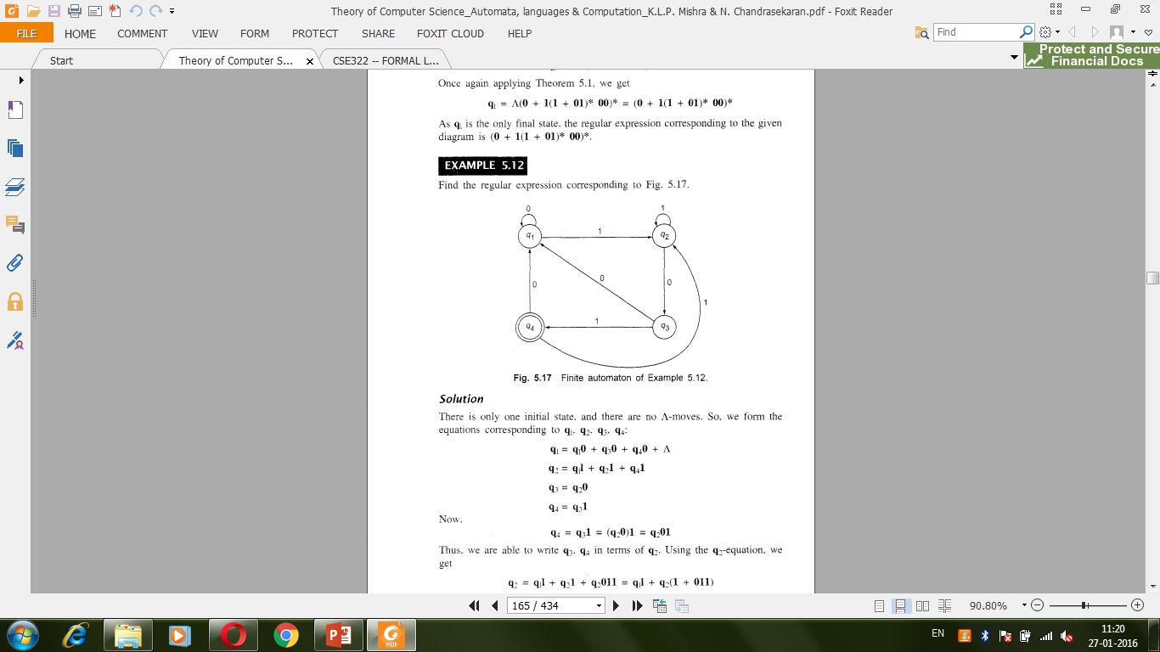
Construct RE from given DFA
Q1 as initial state

Slide 45
(0 + 1(1 + 011)*(00 + 010)*(1(1 + 011)* 01)

Slide 46
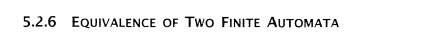
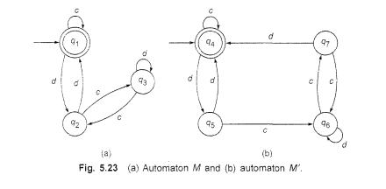

Slide 47
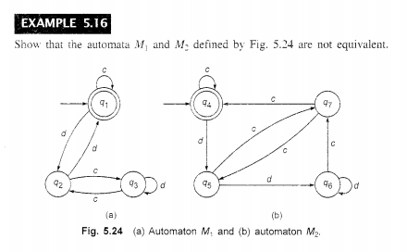

Slide 48
Closure properties of regular sets
Property 1. The union of two regular set is regular.
Proof −
Let us take two regular expressions
RE₁ = a(aa)* and RE₂ = (aa)*
So, L₁ = {a, aaa, aaaaa,.....} (Strings of odd length excluding Null)
and L₂ ={ ε, aa, aaaa, aaaaaa,.......} (Strings of even length including Null)
L₁ ∪ L₂ = { ε, a, aa, aaa, aaaa, aaaaa, aaaaaa,.......}
(Strings of all possible lengths including Null)
RE (L₁ ∪ L₂) = a* (which is a regular expression itself)
Hence, proved.

Slide 49
Closure properties of regular sets
Property 2. The intersection of two regular set is regular.
Proof −
Let us take two regular expressions
RE₁ = a(a*) and RE₂ = (aa)*
So, L₁ = { a,aa, aaa, aaaa, ....} (Strings of all possible lengths excluding Null)
L₂ = { ε, aa, aaaa, aaaaaa,.......} (Strings of even length including Null)
L₁ ∩ L₂ = { aa, aaaa, aaaaaa,.......} (Strings of even length excluding Null)
RE (L₁ ∩ L₂) = aa(aa)* which is a regular expression itself.
Hence, proved.

Slide 50
Closure properties of regular sets
Property 3. The complement of a regular set is regular.
Proof −
Let us take a regular expression −
RE = (aa)*
So, L = {ε, aa, aaaa, aaaaaa, .......} (Strings of even length including Null)
Complement of L is all the strings that is not in L.
So, L’ = {a, aaa, aaaaa, .....} (Strings of odd length excluding Null)
RE (L’) = a(aa)* which is a regular expression itself.
Hence, proved.

Slide 51
Closure properties of regular sets
Property 4. The difference of two regular set is regular.
Proof −
Let us take two regular expressions −
RE₁ = a (a*) and RE₂ = (aa)*
So, L₁ = {a, aa, aaa, aaaa, ....} (Strings of all possible lengths excluding Null)
L₂ = { ε, aa, aaaa, aaaaaa,.......} (Strings of even length including Null)
L₁ – L₂ = {a, aaa, aaaaa, aaaaaaa, ....}
(Strings of all odd lengths excluding Null)
RE (L₁ – L₂) = a (aa)* which is a regular expression.

Slide 52
Closure properties of regular sets
Property 5. The reversal of a regular set is regular.
Proof −
We have to prove L^{R} is also regular if L is a regular set.
Let, L = {01, 10, 11, 10}
RE (L) = 01 + 10 + 11 + 10
L^{R} = {10, 01, 11, 01}
RE (L^{R}) = 01 + 10 + 11 + 10 which is regular
Hence, proved.
Property 6. The closure of a regular set is regular.
Proof −
If L = {a, aaa, aaaaa, .......} (Strings of odd length excluding Null)
i.e., RE (L) = a (aa)*
L* = {a, aa, aaa, aaaa , aaaaa,……………} (Strings of all lengths excluding Null)
RE (L*) = a (a)*
Hence, proved.

Slide 53
Closure properties of regular sets
Property 7. The concatenation of two regular sets is regular.
Proof −
Let RE₁ = (0+1)*0 and RE₂ = 01(0+1)*
Here, L₁ = {0, 00, 10, 000, 010, ......} (Set of strings ending in 0)
and L₂ = {01, 010,011,.....} (Set of strings beginning with 01)
Then, L₁ L₂ = {001,0010,0011,0001,00010,00011,1001,10010,.............}
Set of strings containing 001 as a substring which can be represented by an RE − (0 + 1)*001(0 + 1)*

Slide 54
Construct DFA Equivalent to regular expression
(0 +1 )*(00 + 11)(0 + 1)*
10 + (0 + 11)0*1

Slide 55
Equivalence of 2 regular expression
Prove (a + b)* =a*(ba*)* by constructing regular expressions

Slide 56
CONSTRUCTION OF A REGULAR GRAMMAR
GENERATING T(M) FOR A GIVEN DFA M
Construct a regular grammar G generating the regular set represented by
P = a*b(a + b)*.

Slide 57
CONSTRUCTION OF A TRANSITION SYSTEM M
ACCEPTING L(G) FOR A GIVEN REGULAR
GRAMMAR G
Let G =({Ao, A1,, {a. b}. P, Ao). where P consists of Ao->aA1,A1->bA1,A1->a,A1->bA0
Construct a transition system M accepting L(G).

Slide 58
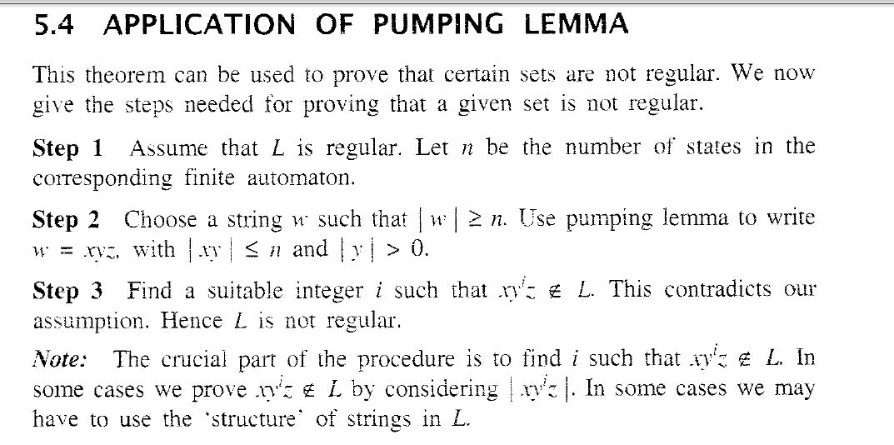
Pumping Lemma

